Slide 1
UNIX File system call
open
read
write
lseek
close
creat
mknod
pipe
dup
mount, umount
link, unlink
VFS and NFS

Slide 2
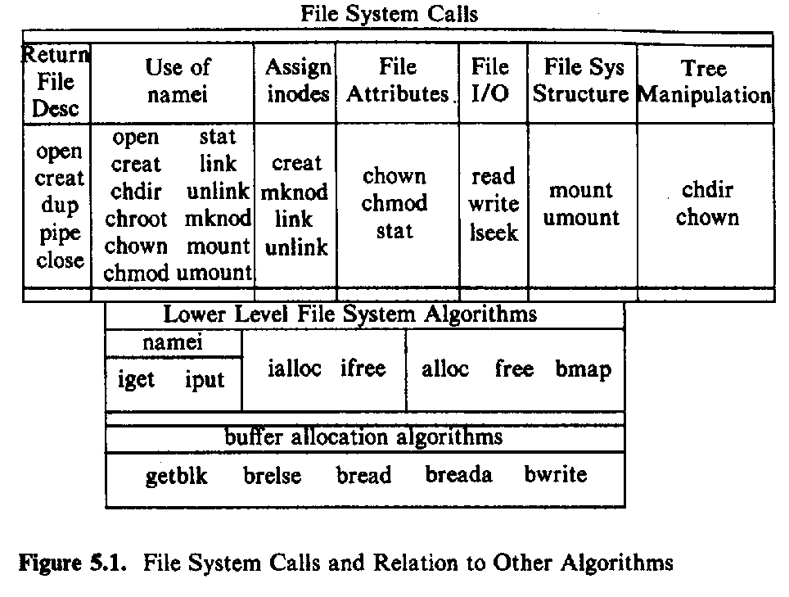
the layer of the file system module

Slide 3
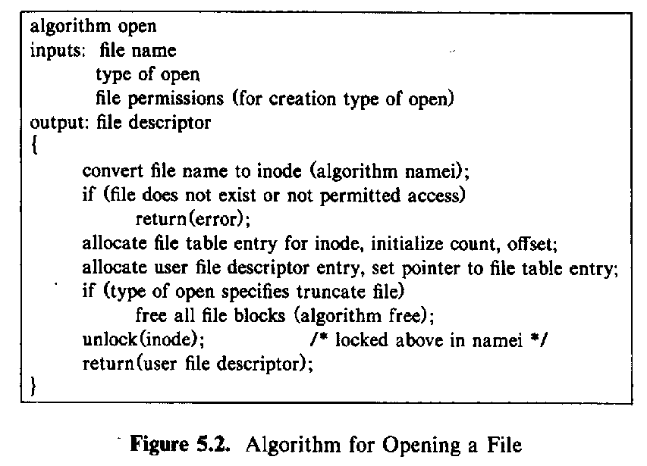
open algorithm

Slide 4
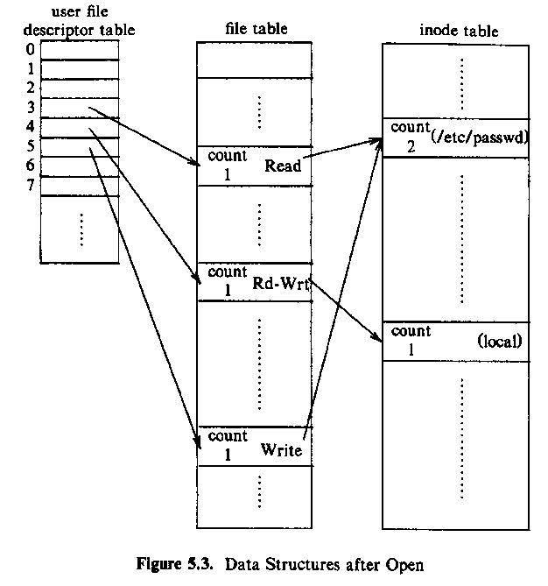

data structure of opened files
Notes:
any open

Slide 5
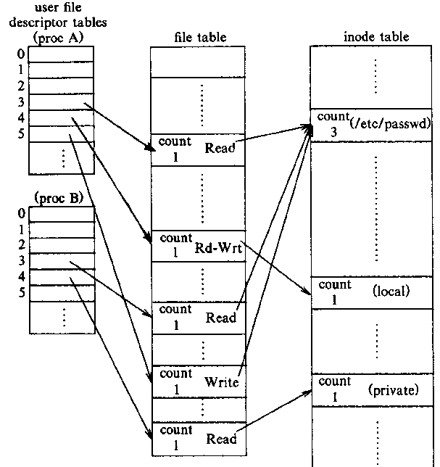
two processes open files

Slide 6
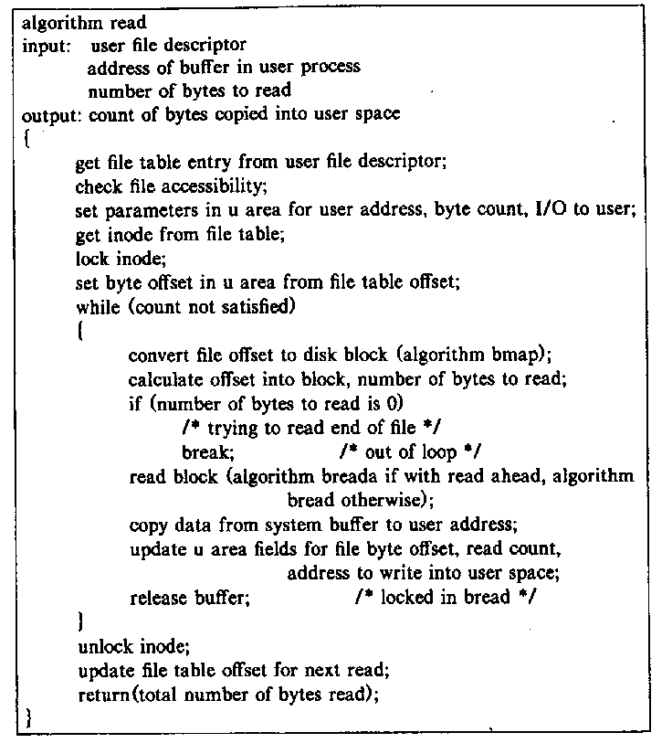
2 read algorithm

Slide 7
2 read algorithm

Slide 8
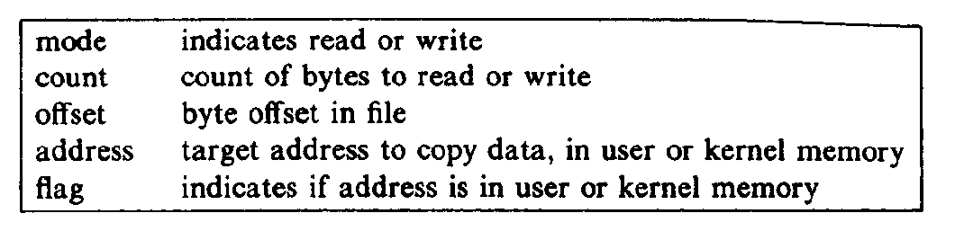
I/O parameters saved in U area
refer to

Slide 9
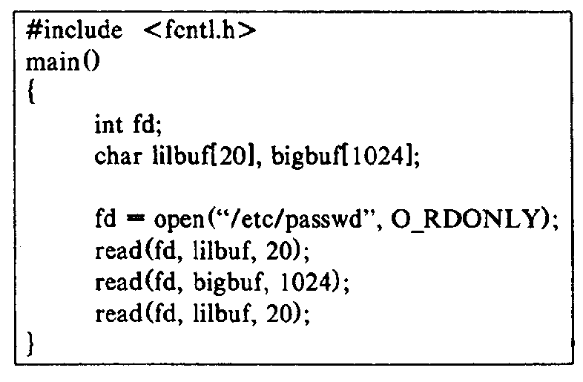
example: read a file
Block size is 1024
internally the data are read block by block, so it needs to access the disk 2 times(using “breada”)

Slide 10
write, lseek, close
write(fd, prt , size)
  write the block， block by block
  if ptr is less than a block, load the block to memory,write to the buffer, at last write to the disk
  if the prt is bigger than the block,write to a new block in memory
  allocate a new disk block for the file(maybe more for indirect block)
lseek
close
  when the process exit(), the kernel close all the opened file

Slide 11
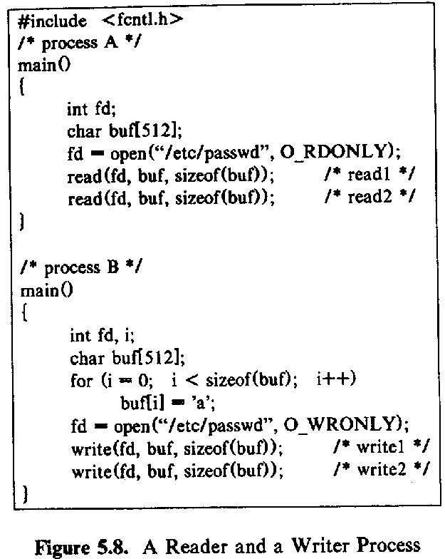
reader and writer
(with no synchronization)
UNIX file system don’t provide
the synchronization mechanism
,so the content of buf in reader
depends on the executing
sequence of “read” and “write”.
VS
The kernel lock the incore Inode and block

Slide 12
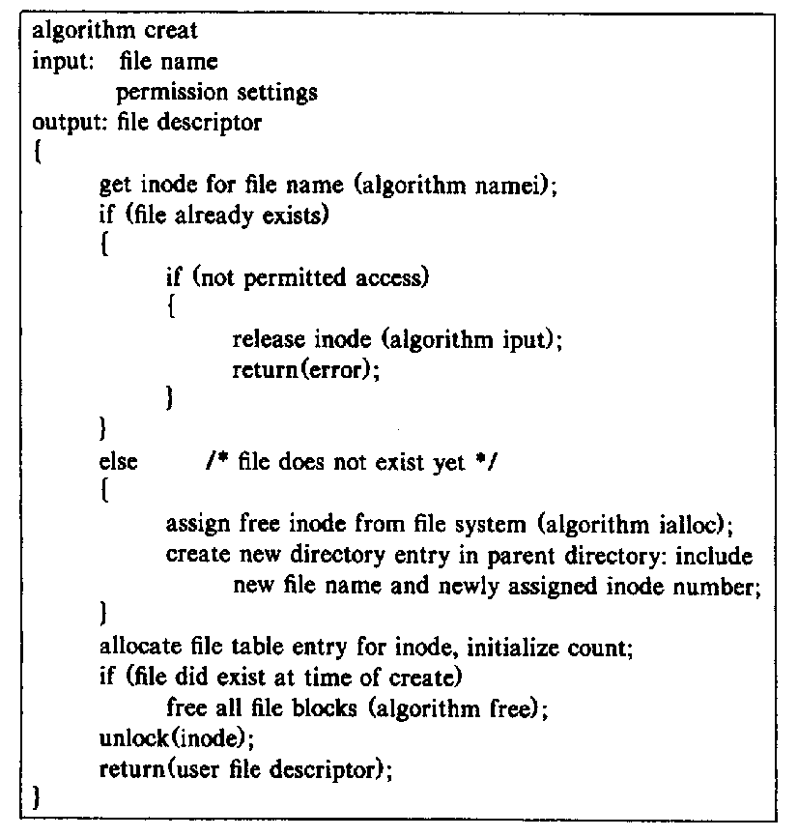
creat

Slide 13
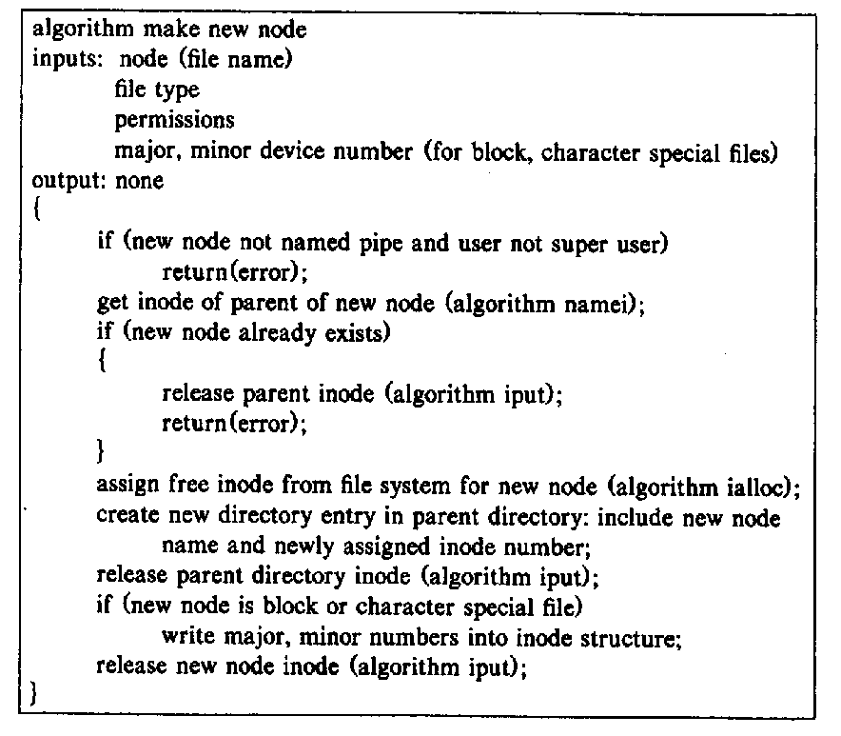
mknod----create a special file

Slide 14
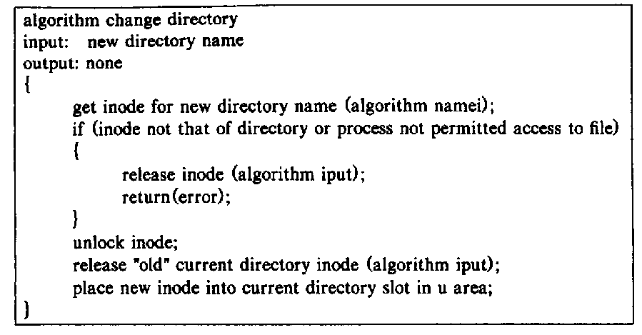
chdir and chroot

Slide 15
chown
chmod
state, fstate

Slide 16
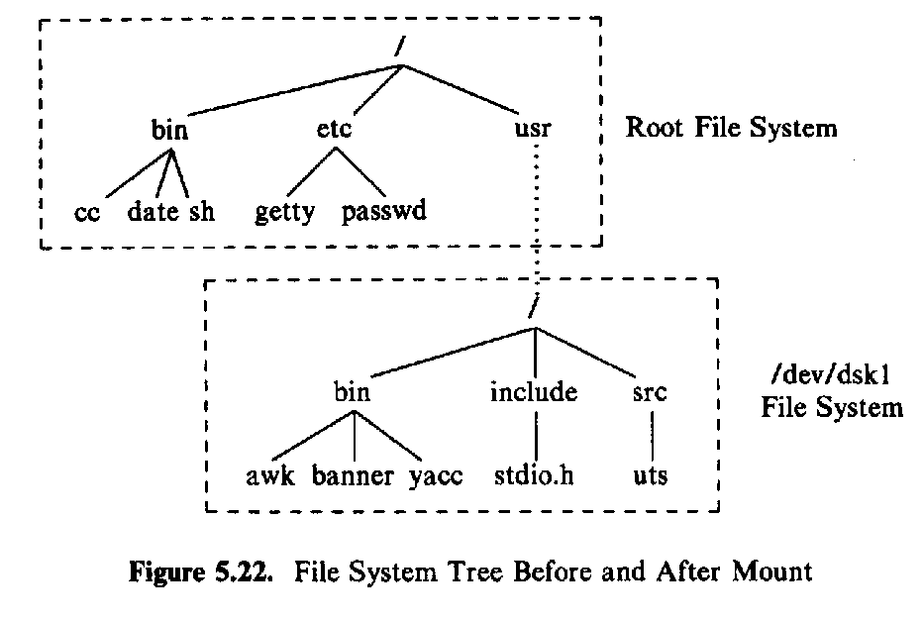
mount

Slide 17
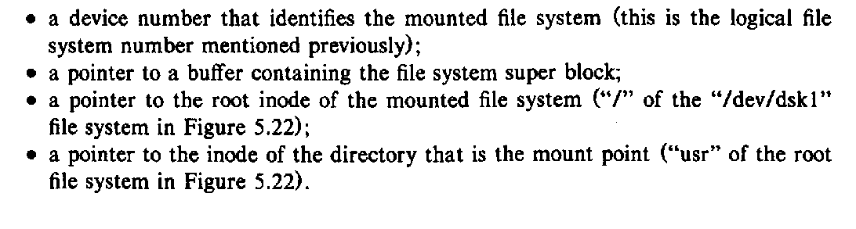
data structure
mounted device number
mounted file system super block
root inode of mounted file system
mount point inode

Slide 18
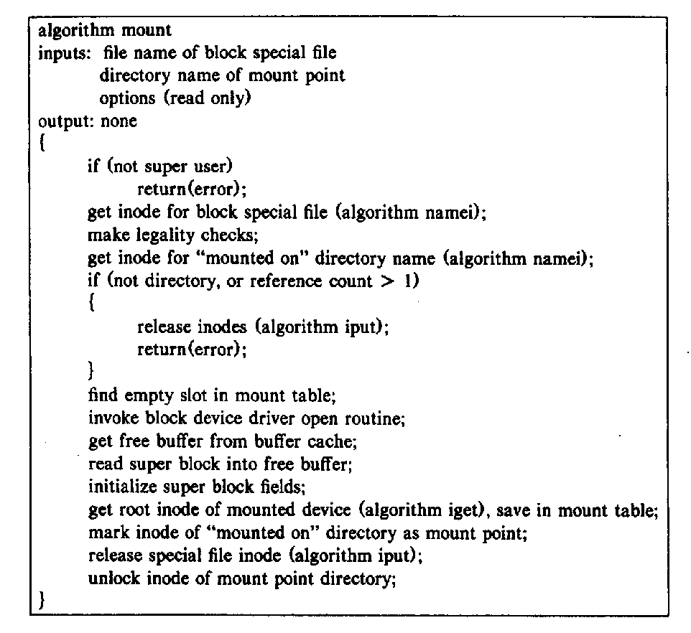
mount

Slide 19
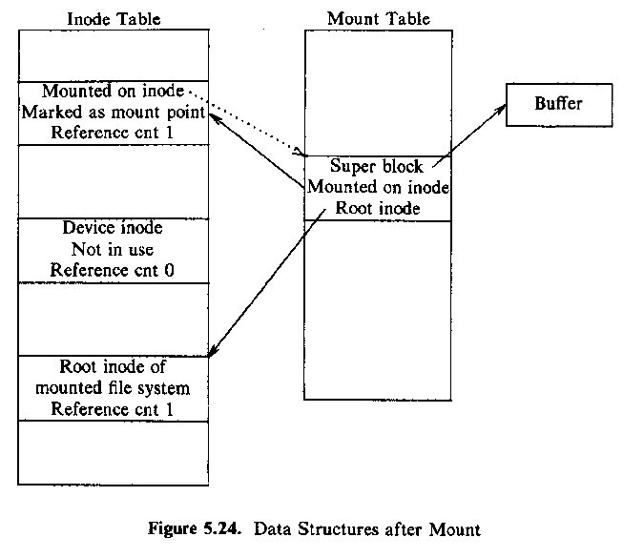
data structures after mount

Slide 20
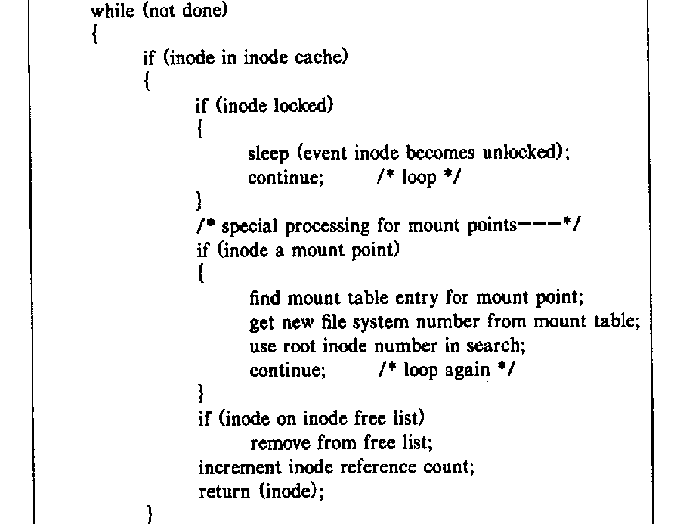
iget --- with the mounted file system

Slide 21
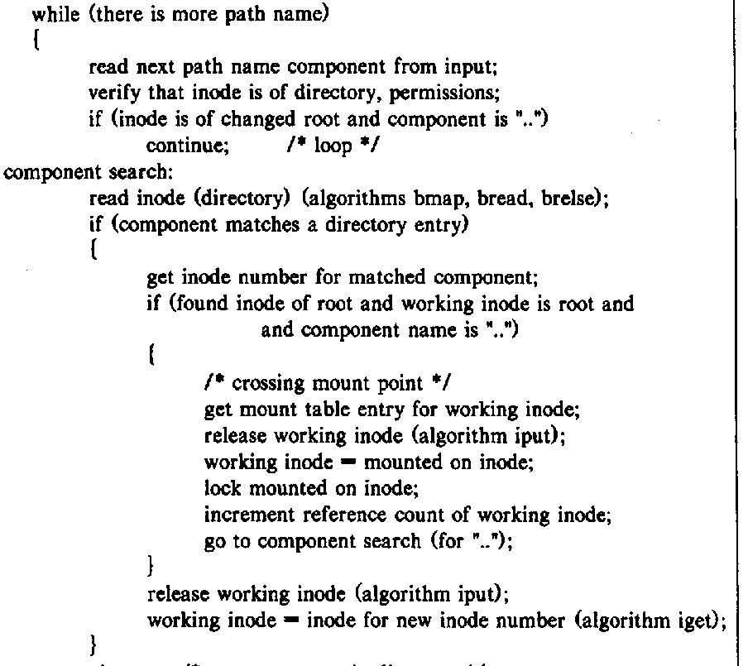
namei –with mounted file system

Slide 22
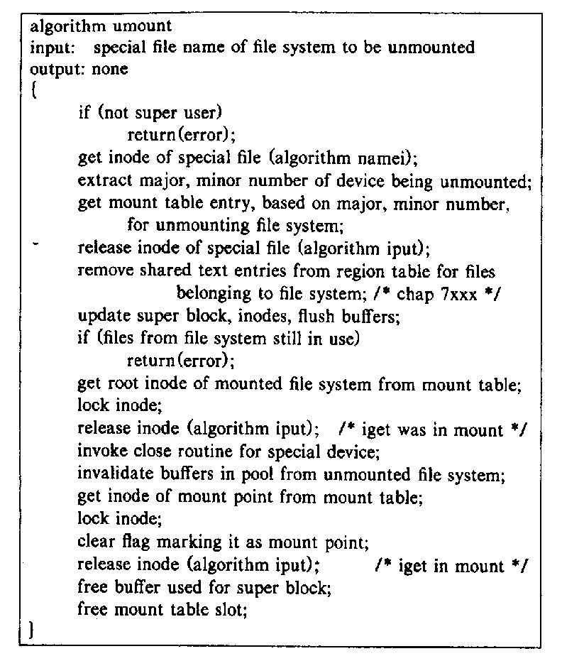
umount

Slide 23
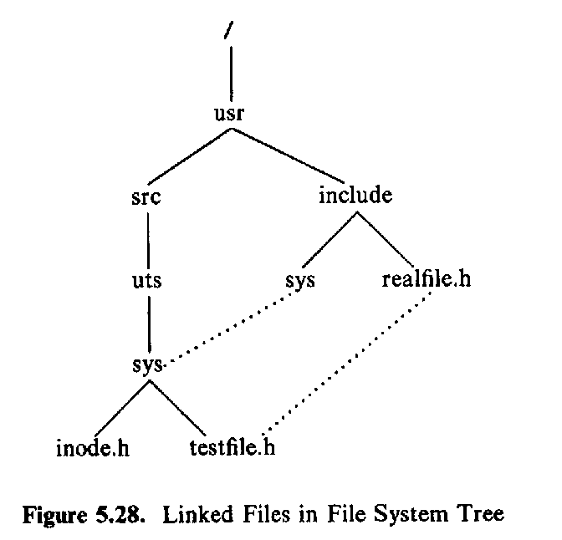
link
link(source, target)

Slide 24
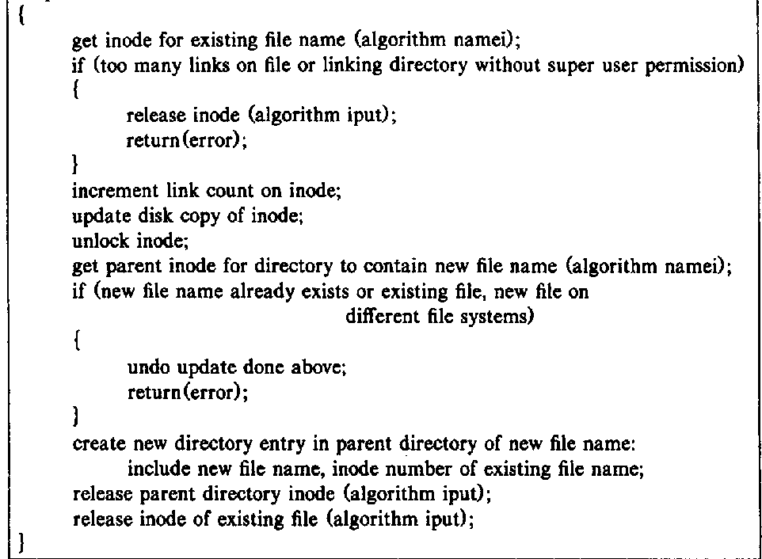
link algorithm

Slide 25
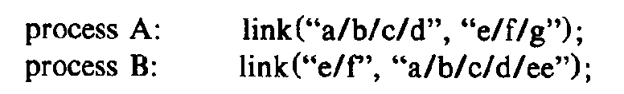
deadlock

Slide 26
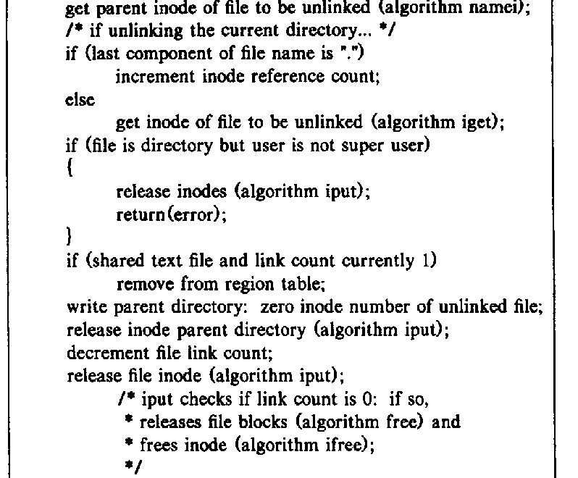
unlink

Slide 27
consistency of file system
the operation order of unlink
unlink( /home/usr/a )
241
a
data block
lnk=1
inode 241

Slide 28
race condition
inode is not available
  process A: namei(a/b/c/d) goto sleep while iget(c)
  process B: namei(a/b/c/d) and unlink( c )
inode is not wanted
  process A: namei(a/b/c/d) goto sleep while iget(c)
  process B: namei(a/b/c/d) and unlink( c ) , mknod( c )
unlink an opened file

Slide 29
Virtual File Systems
Virtual File Systems (VFS) provide an object-oriented way of implementing file systems.
VFS allows the same system call interface (the API) to be used for different types of file systems.

Slide 30
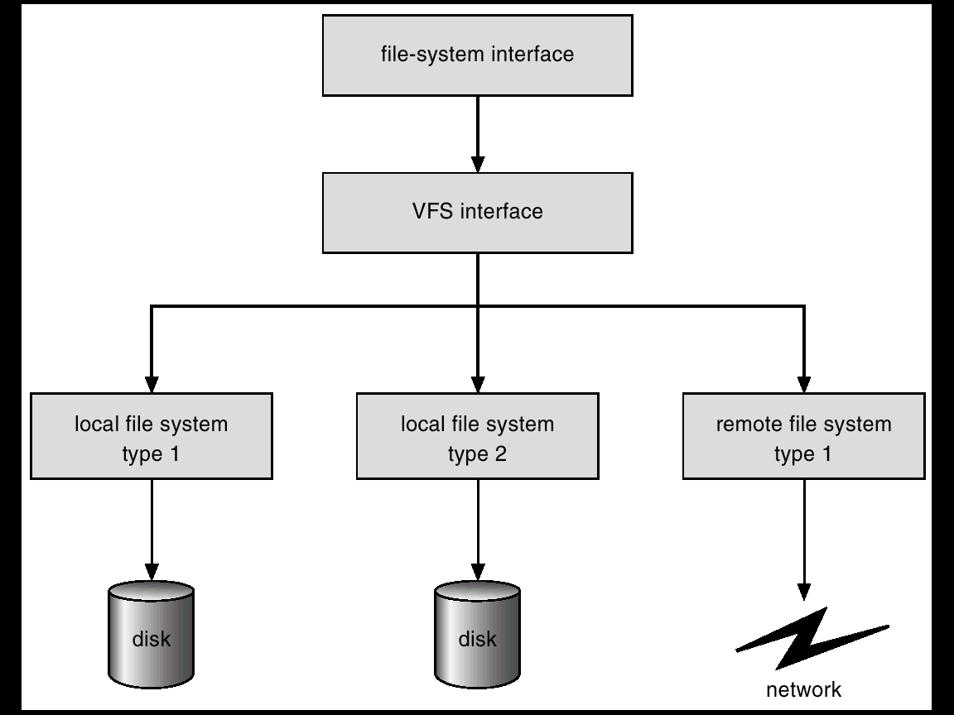
Schematic View of Virtual File System

Slide 31
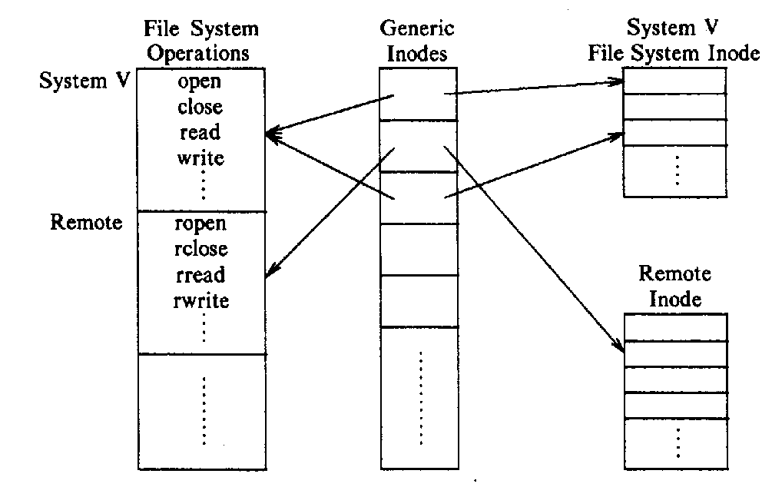
abstract file system

Slide 32
The Sun Network File System (NFS)
An implementation and a specification of a software system for accessing remote files across LANs (or WANs).
The implementation is part of the Solaris and SunOS operating systems running on Sun workstations using an unreliable datagram protocol (UDP/IP protocol and Ethernet.

Slide 33
NFS (Cont.)
Interconnected workstations viewed as a set of independent machines with independent file systems, which allows sharing among these file systems in a transparent manner.
  A remote directory is mounted over a local file system directory. The mounted directory looks like an integral subtree of the local file system, replacing the subtree descending from the local directory.
  Specification of the remote directory for the mount operation is nontransparent; the host name of the remote directory has to be provided. Files in the remote directory can then be accessed in a transparent manner.
  Subject to access-rights accreditation, potentially any file system (or directory within a file system), can be mounted remotely on top of any local directory.

Slide 34
NFS (Cont.)
NFS is designed to operate in a heterogeneous environment of different machines, operating systems, and network architectures; the NFS specifications independent of these media.
This independence is achieved through the use of RPC primitives built on top of an External Data Representation (XDR) protocol used between two implementation-independent interfaces.
The NFS specification distinguishes between the services provided by a mount mechanism and the actual remote-file-access services.

Slide 35
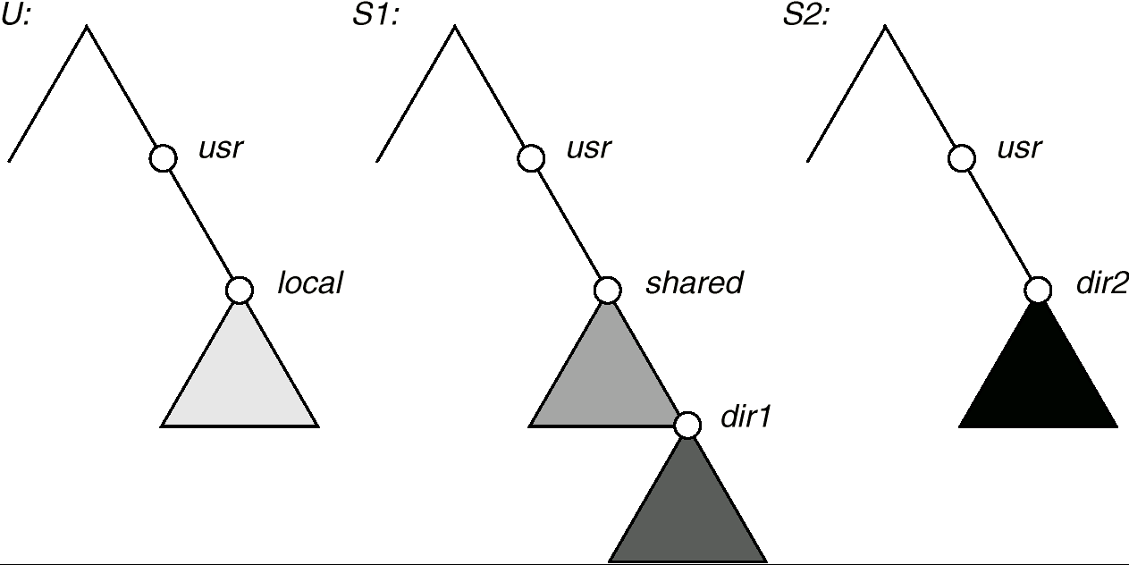
Three Independent File Systems

Slide 36
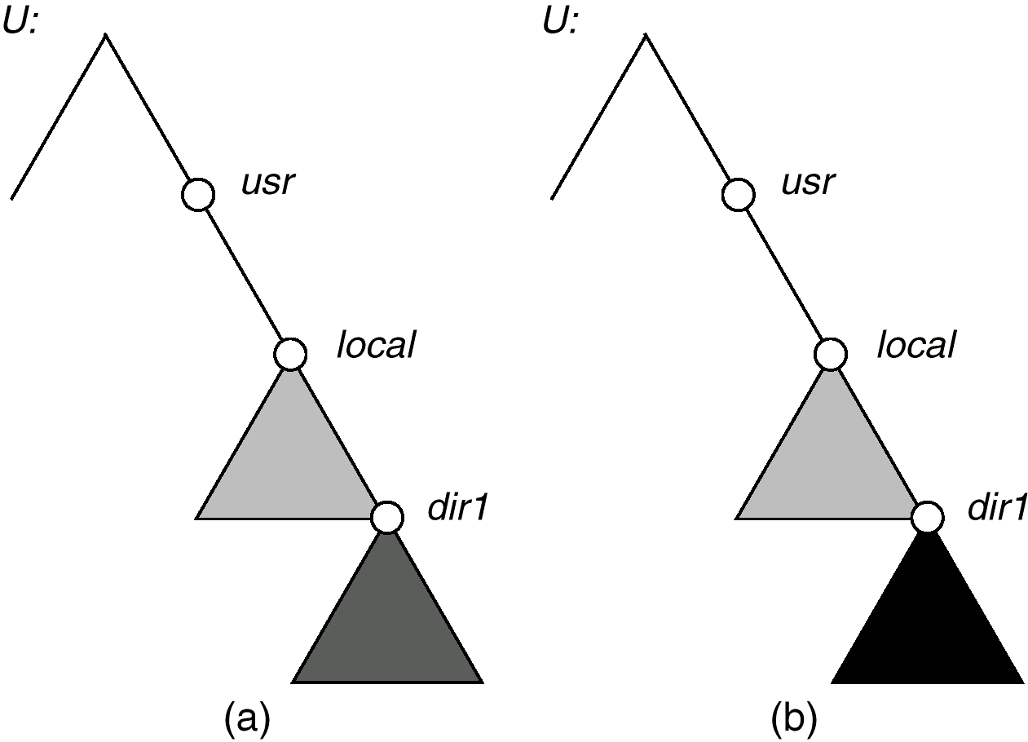
Mounting in NFS
Mounts
Cascading mounts

Slide 37
NFS Mount Protocol
Establishes initial logical connection between server and client.
Mount operation includes name of remote directory to be mounted and name of server machine storing it.
  Mount request is mapped to corresponding RPC and forwarded to mount server running on server machine.
  Export list – specifies local file systems that server exports for mounting, along with names of machines that are permitted to mount them.
Following a mount request that conforms to its export list, the server returns a file handle—a key for further accesses.
File handle – a file-system identifier, and an inode number to identify the mounted directory within the exported file system.
The mount operation changes only the user’s view and does not affect the server side.

Slide 38
NFS Protocol
Provides a set of remote procedure calls for remote file operations. The procedures support the following operations:
  searching for a file within a directory
  reading a set of directory entries
  manipulating links and directories
  accessing file attributes
  reading and writing files
NFS servers are stateless; each request has to provide a full set of arguments.
Modified data must be committed to the server’s disk before results are returned to the client (lose advantages of caching).
The NFS protocol does not provide concurrency-control mechanisms.

Slide 39
Three Major Layers of NFS Architecture
UNIX file-system interface (based on the open, read, write, and close calls, and file descriptors).
Virtual File System (VFS) layer – distinguishes local files from remote ones, and local files are further distinguished according to their file-system types.
  The VFS activates file-system-specific operations to handle local requests according to their file-system types.
  Calls the NFS protocol procedures for remote requests.
NFS service layer – bottom layer of the architecture; implements the NFS protocol.

Slide 40
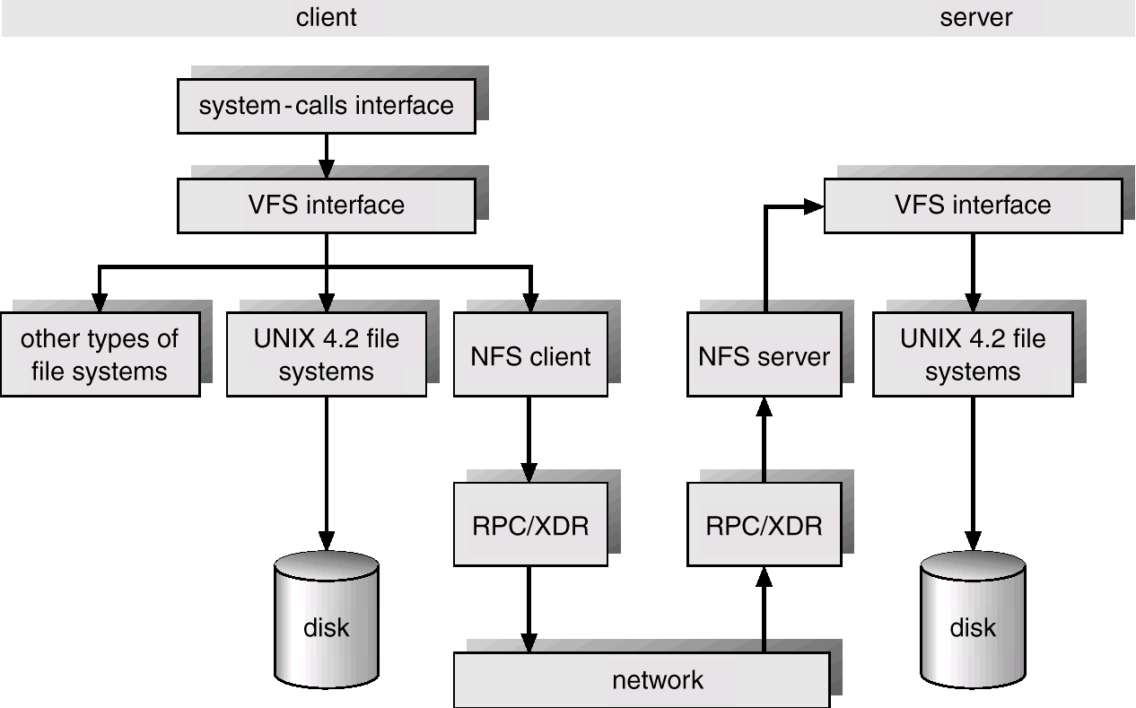
Schematic View of NFS Architecture

Slide 41
NFS Path-Name Translation
Performed by breaking the path into component names and performing a separate NFS lookup call for every pair of component name and directory vnode.
To make lookup faster, a directory name lookup cache on the client’s side holds the vnodes for remote directory names.

